Slide 1
Encrypting Secret
Texts Messages Inside an Image
Using Steganography
Vinayak Renu Nair ,Dawit Abey

Slide 2
CONTENTS
Introduction
What is Steganography
Project Objective
Packages Used
Code for encoding
Code for decoding
Demo

Slide 3

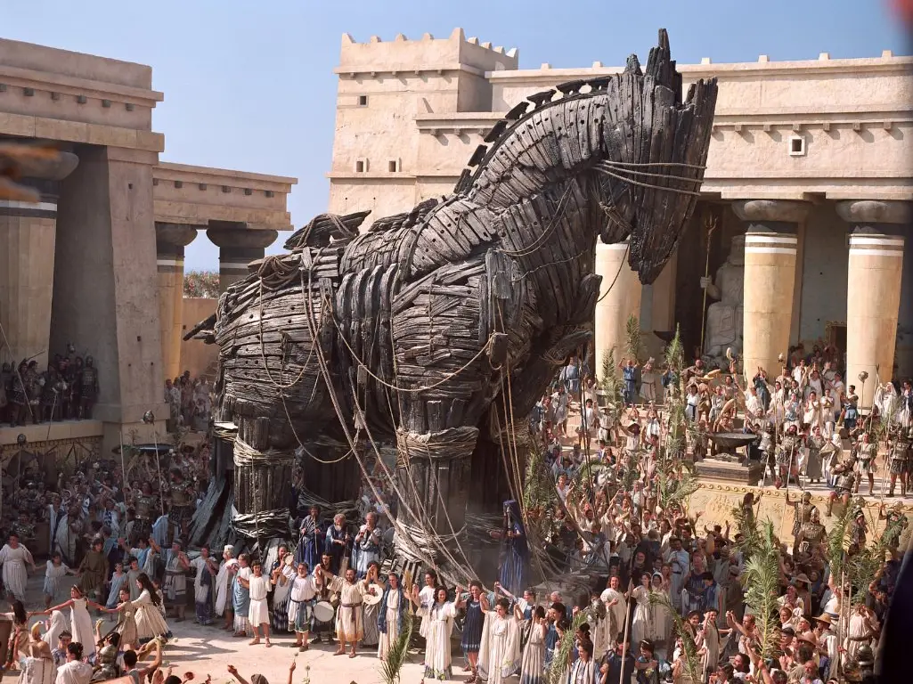
INTRODUCTION
Consider the possibility of concealing secret messages within an image. The image does not appear to have changed. It appears to be any other ordinary image, but it will have some data contained in it.

Slide 4
What is Stenography ?
Consider the possibility of concealing secret messages within an image. The image does not appear to have changed. It appears to be any other ordinary image, but it contains some data.
Steganography is a form of security technique through obscurity, the science and art of hiding the existence of a message between sender and intended recipient.
Steganography has been used to hide secret messages in various types of files, including digital images, audio and video.
Different applications have different requirements of the steganography technique used.

Slide 5
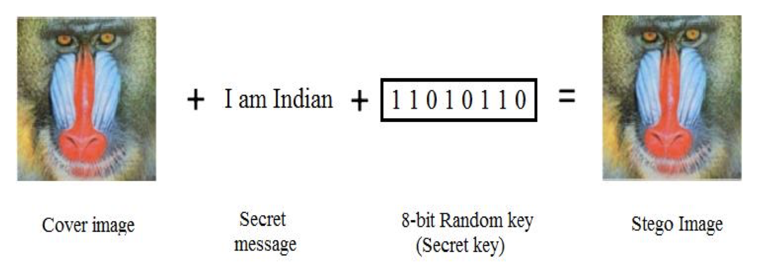
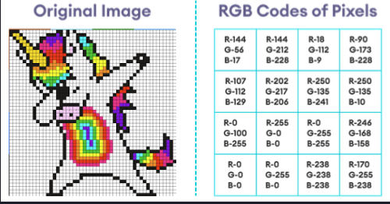
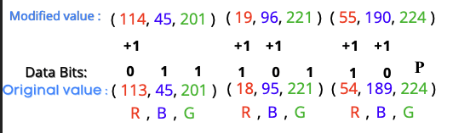
Encoding Message to Image
8-Bits
Every Color contain Red,Green,& Blue
If Bit == 0 then -- > Make the RGB value Even.
If Bit == 1 then -- > Make the RGB value Odd.
P is Odd when message ends here
P is even when message continues

Slide 6
Project objective
Using steganography technique, we try to develop a program that will encode and decode an image using Python.

Slide 7
Packages used :
colorama
commonmark
Pillow
pycryptodome
pyfiglet
Pygments
rich
termcolor
typing-extensions
Notes:
Colorama - colored text in the terminal
Commonmark - it is used for parsing the text
Pillow - used for opening, manipulating and saving images
Pycryptodome - it is a library that provides implementation of AES, stream cipher etc.
Pyglet - provides an object-oriented application programming interface for the creation of games and other multimedia applications
rich - displaying advanced content such as tables, markdown, and syntax highlighted code
Termcolor - Color formatting for output in the terminal

Slide 8
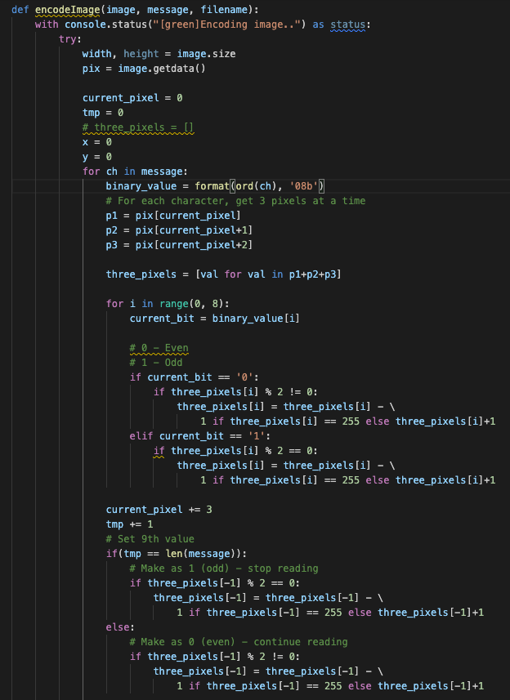
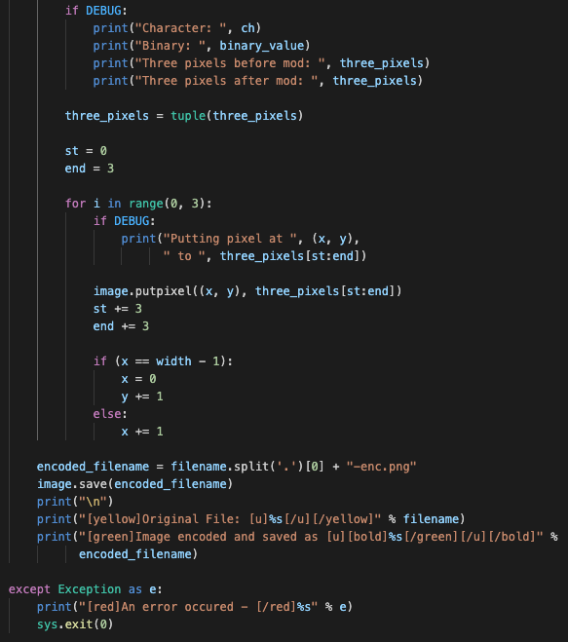
Code for Encoding

Slide 9
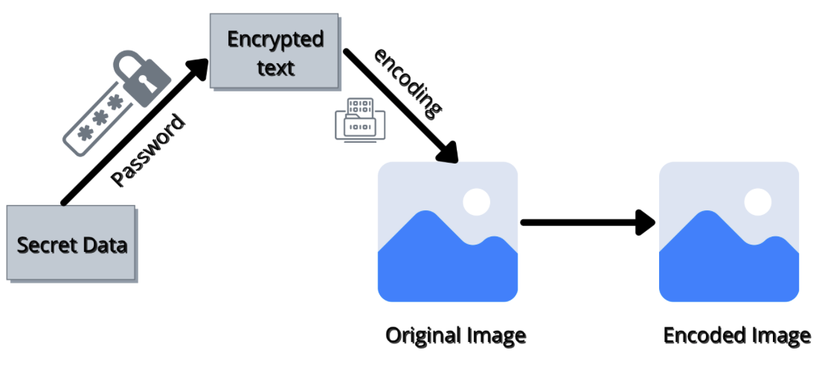
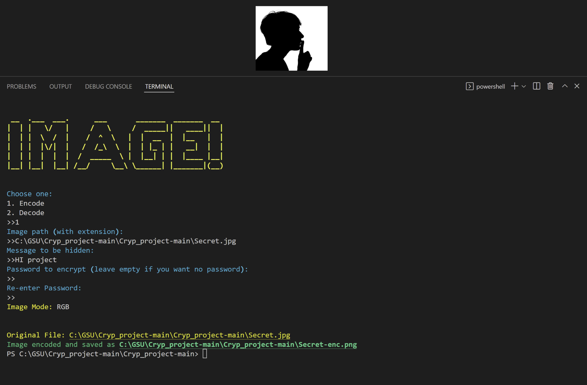
Encode Output

Slide 10
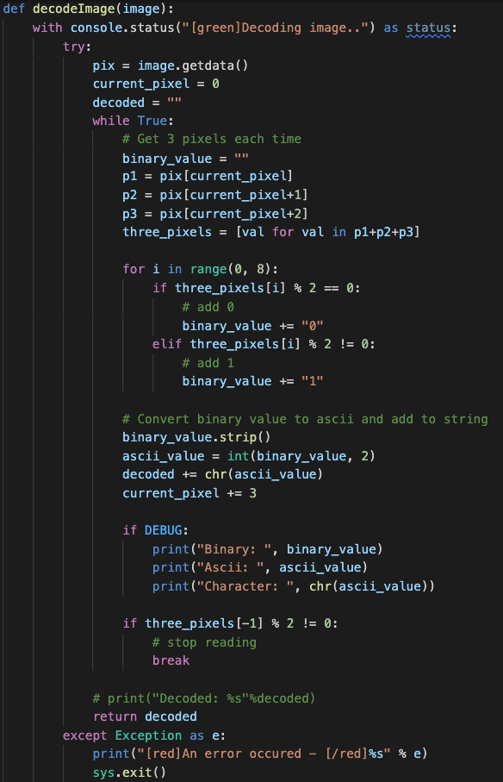
Code for Decoding

Slide 11
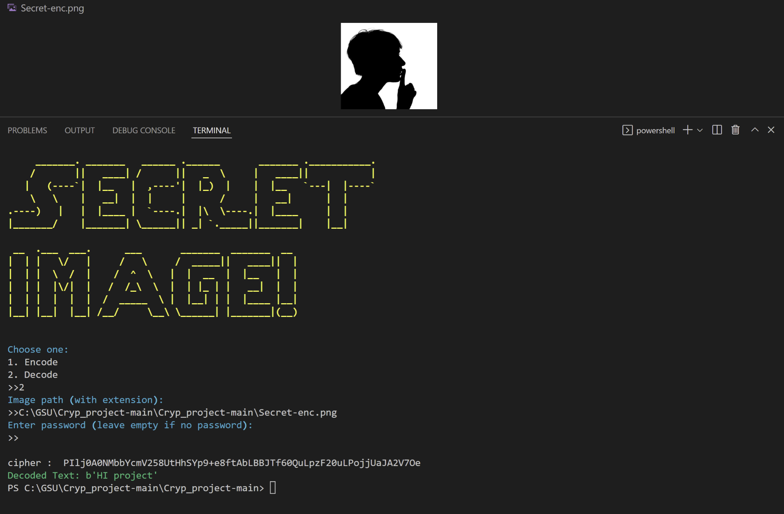
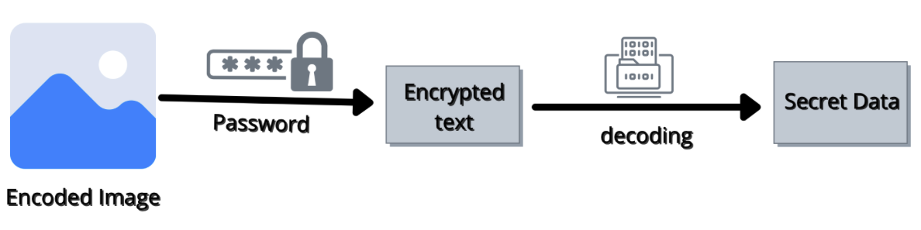
Decode Output

Slide 12
Conclusion
Image compression is a useful technology that helps save memory space and time while transferring images over a network.
This helps to increase storage capacity as well as transfer speed.

Slide 13
Thank you!
Code Demo

